Slide 1
Jillian Wisniewski
SDM ‘14

Slide 2
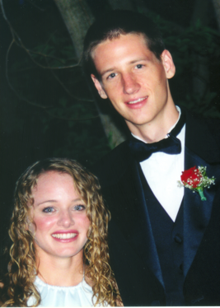
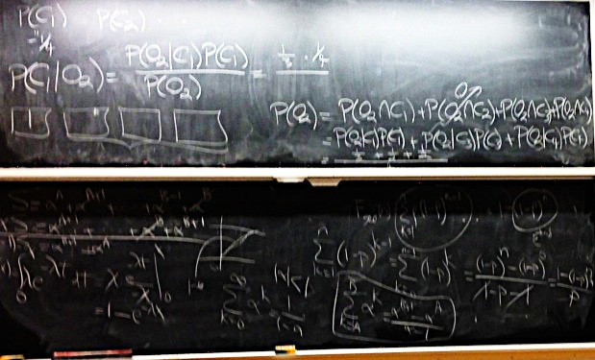
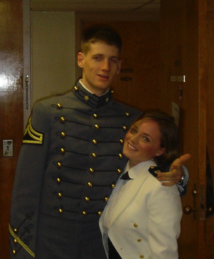
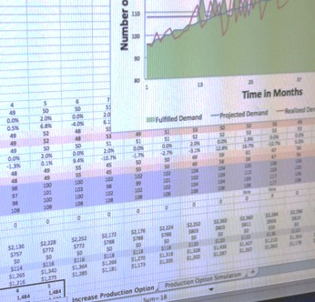
About Me
High School Class of ‘02
West Point Class of ‘06

Slide 3
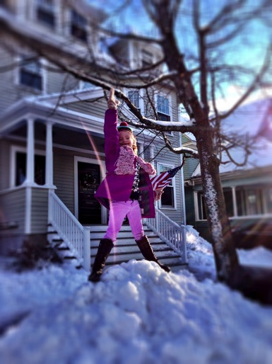
SDM ’14 We know it won’t be easy…
“I’m an excellent climber—I always find solid footing.”
-Anna Wisniewski

