Slide 1
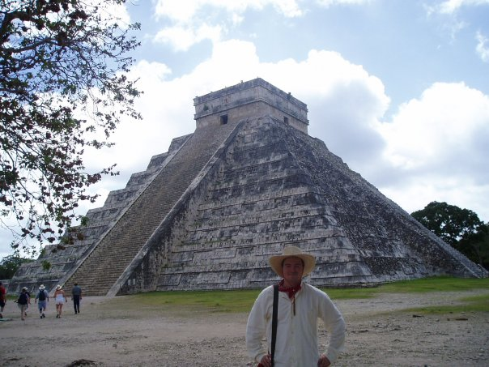
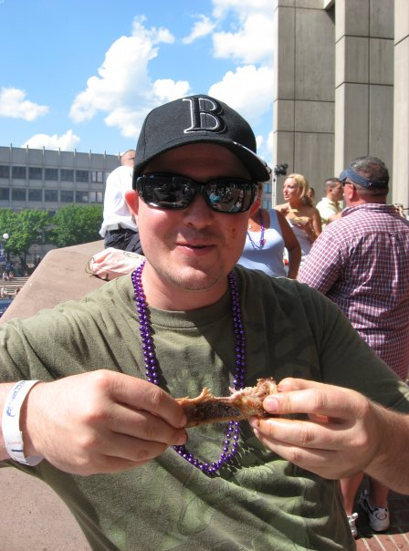
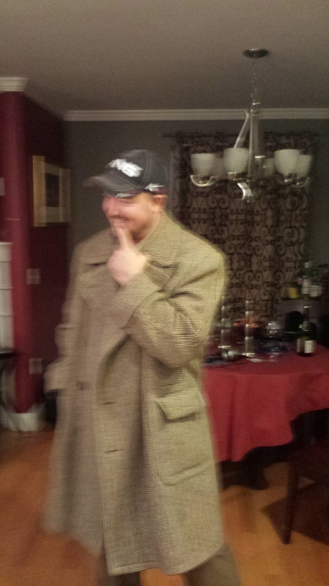
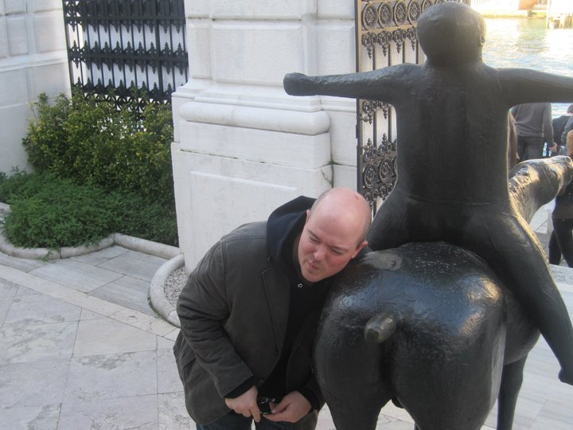
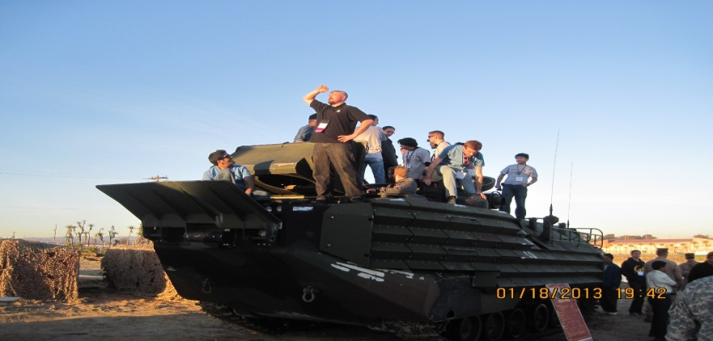
Jim Barkley
The man, the myth, the legend

Slide 2
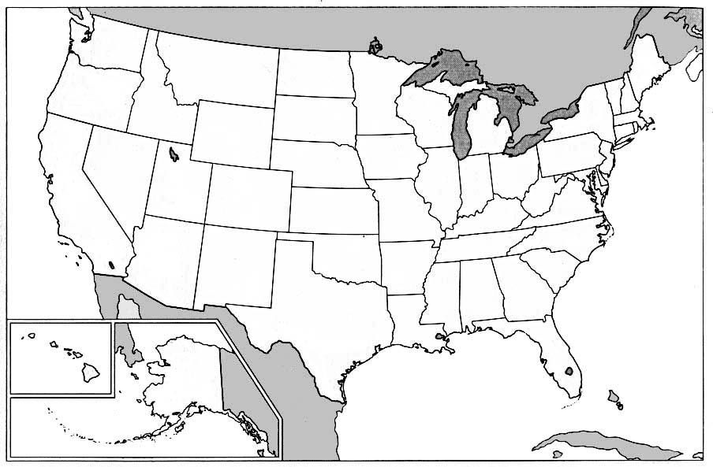
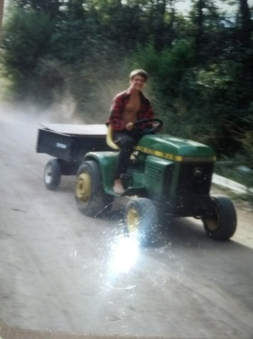
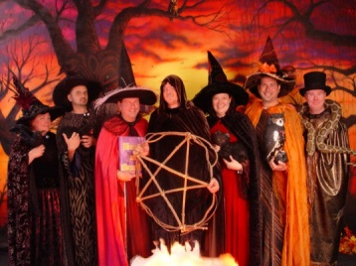
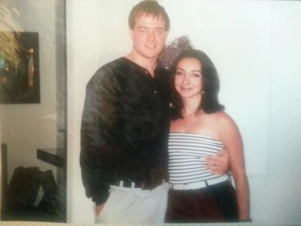
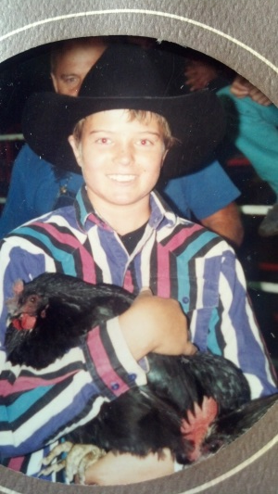
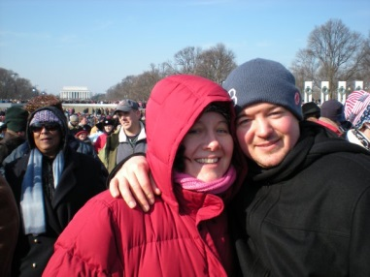
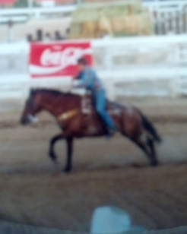
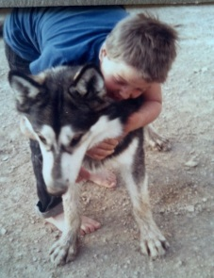
BACKGROUND
Salem,
MA
Boulder, CO
DeBeque, CO
Denver, CO
Washington, DC
Guantanamo Bay, Cuba

Slide 3
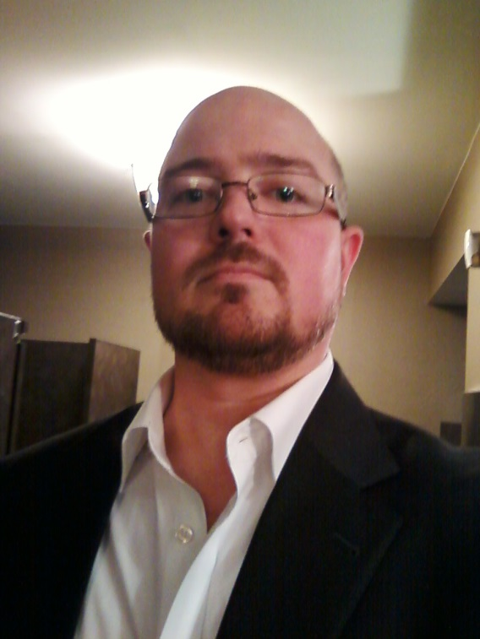
STATS
NAME : James (Jim)
UNDERGRAD: Computer Science
BACKGROUND: Modeling & simulation, open source software/hardware, web development, robotics/sensors, environmental programming, big data, information security, health
HOBBIES & INTERESTS: playing piano, teaching/learning, poetry, hacking, running
COMPANY: The MITRE Corporation
CURRENT ROLE: Principle Software Systems Engineer
CURRENT PROJECT: Patient Safety Initiative
AGE: 33
CORE VALUES: Fairness, competency, self-awareness, honesty

Slide 4
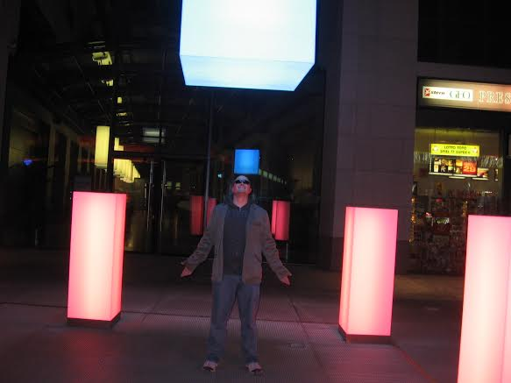
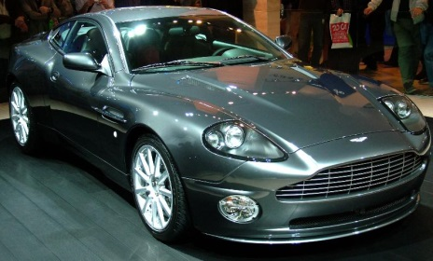
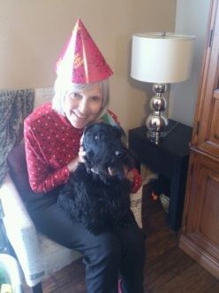
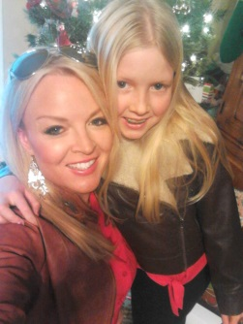
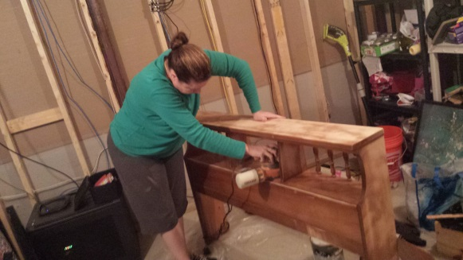
SO WHY AM I HERE?
Midlife crisis?
Get mom off my back?
Sibling superiority?
Maybe my wife will stop lording her MBA over me?
THE truth is… I want to do world class work in this lifetime.

Slide 5
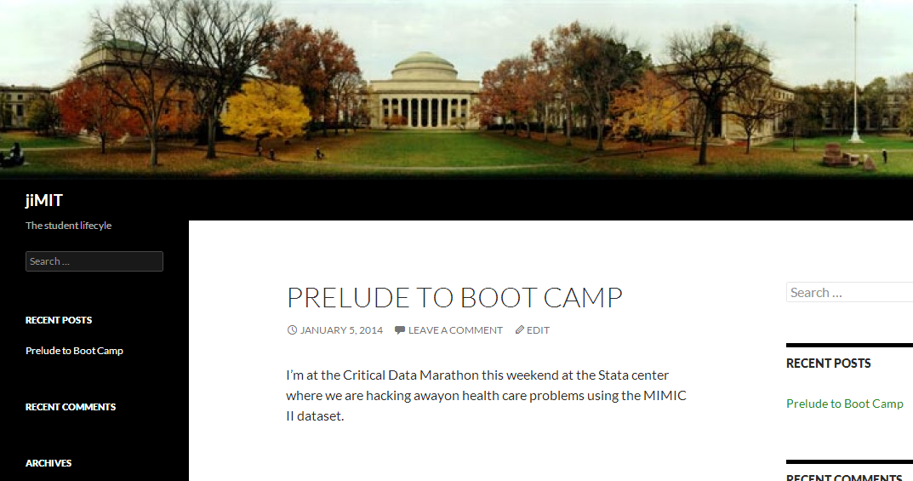
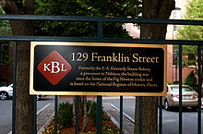
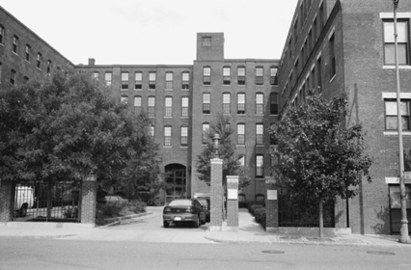
ADVERTISMENTS
Boot camp blog
http://jiMIT.net/
cido048sowe@post.wordpress.com
Sublet available in Central Square!

